Slide 1
Arrays and Loops
Front-End Web Development

Slide 2
Lesson 14 Change Log FEWD 3.1 - 3.2
Below are the specific changes made in this lesson.
Returning Instructor Directions:
Click on the hyperlinks below, and it will direct you to the specific slide.
Copy the entire slide, and paste in your existing curriculum deck.
Pre-Class Materials and Preparation -
Added warmup activities to the new CodePen collection “Warmups”.
Added new CodePen — Interactive Favorite Foods Array — to Reference Code.
Added new CodePens — Loops Practice, Song Lyrics, FizzBuzz Practice — to Starter and Solution Code.
Share how the lesson went through our Instructor Lesson Exit Ticket - the Curriculum Feedback form: http://ga.co/curriculum-feedback

Slide 3
Pre-Class Materials and Preparation
Review all slides, lab activities, and code-alongs.
There are prompts in the speaker notes with opportunities for instructor customization.
Materials:
Reference Code
Starter Code in CodePen
Solution Code in CodePen
Warmups in CodePen

Slide 4
Arrays and Loops
Overview
This lesson continues the basics of JavaScript with arrays and loops.
Learning Objectives
In this lesson, students will:
Use arrays and loops in JavaScript to manage collections of data.
Invoke array methods to manipulate the contents of an array.
Distinguish between for loops and while loops.
Duration: 180 minutes

Slide 5
Suggested Agenda
Time | Activity | Purpose
0:00–0:45 | Arrays and Array Methods Reference | Show how arrays are defined and operate in JS.
0:45–1:15 | Interactive Fruit Basket Walk-Through | Shows how arrays can be used to manage collections of data that are displayed on the screen. Also shows jQuery as an alternative form of DOM manipulation.
1:15–2:00 | Loops | Introduce and compare for loops versus while loops
2:00–3:00 | Demo/Code Challenges With Loops and Functions | At this point, you should be able to give students code challenges in JavaScript to practice what they've learned so far. Things like "find the maximum number in an array" are good challenges at this stage.

Slide 6
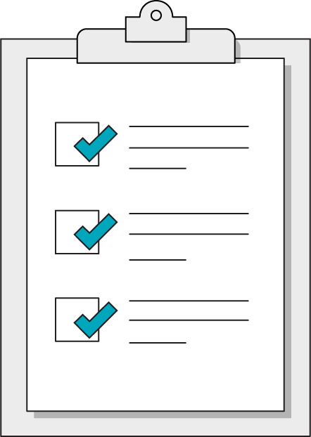
Today’s Learning Objectives
In this lesson, you will:
Use arrays and loops in JavaScript to manage collections of data.
Invoke array methods to manipulate the contents of an array.
Distinguish between for loops and while loops.
‹#› | © 2020 General Assembly
Notes:
DURATION: 1 minute
TEACHING TIPS:
Learning objectives help frame the lesson and give students an idea of what to expect and focus on.
Explain to students how this lesson fits into the overall course to help them make connections with content from other lessons.

Slide 7
Arrays
Think of arrays as containers of data, structured like a list. Technically, an array is an ordered collection of data types combined into one variable.
Each item in an array is assigned an index value based on its position. These index values allow us to access individual elements within the array.
["banana", "orange", "apple"]
0
1
2

Slide 8
Syntax
const fruits = ["banana", "orange", "apple"]
You make an array using a set of square brackets.
Inside the brackets, each value must be separated by a comma.
Arrays can contain, strings, numbers, booleans, objects or any of these combined.
Notes:
TALKING POINTS:
Although the example above is three strings, it’s possible to store data of any type in any array — even more arrays! It can also be tricky at first to understand that const doesn’t prevent us from changing the stuff inside the array. We just can’t re-assign the variable to a new value.

Slide 9
Why Do Arrays Matter?
Arrays are one of just two types of data “containers” in JavaScript (the other is objects). As a result, much of the data we use comes in the form of arrays.
Arrays come from three main places:
The DOM (with querySelectorAll and getElementsByClassName)
API responses (information received from other web applications)
Databases
Notes:
TEACHING TIPS:
A spreadsheet, for example, would be interpreted by JavaScript as an array of objects. Feel free to expound upon this example if objects have been difficult, as the concept of key-pair values aligns with columns and the stuff filled in the columns.

Slide 10
Accessing Array Values
const fruits = ["banana", "orange", "apple"];
fruits[0]; // will output "banana"
fruits[1]; // will output "orange"
fruits[2]; // will output "apple"
Access array items using square brackets around their index values. It’s pretty simple — just remember that the first index value is always zero!

Slide 11
Array Properties and Methods
Front-End Web Development

Slide 12
.indexOf()
const fruits = ["banana", "orange", "apple"];
fruits.indexOf("orange");
// will return the number 1
Use .indexOf() to see the index value of any item in the array.
Notes:
TEACHING TIPS:
A good prompt to follow up with is: “How could we find out what happens if the item isn’t actually in the array? How about when the item is in the array twice?”
Encourage students to be googling things or, in such a simple case, just TRY IT OUT!

Slide 13
.length
const fruits = ["banana", "orange", "apple"];
fruits.length;
=> 3
Use the .length property to figure out how many items are in your array. This is very useful when we need to look through the whole array with a loop.
Notes:
TEACHING TIPS:
Note that .length is a property, not a method, so it is not .length().
You should move relatively quickly through the following slides, as the point is merely to introduce the properties/methods involved, not to memorize them.
This is a good opportunity to encourage quick researching of methods students know exist — it shouldn’t be hard to google “add item to back of array JavaScript” and find .push as the method. Once again, patterns > details.

Slide 14
Adding an item .push()
const fruits = ["orange"];
fruits.push("kiwi");
// fruits is now: ["orange", "kiwi"];
The .push method adds the item inside the parentheses to the end of the array.

Slide 15
Removing an item .pop()
const fruits = ["banana", "orange", "apple"];
fruits.pop();
// fruits is now: ["banana", "orange"];
The .pop method removes the last item in the array. Can you hear the sound effect when you pop an item off?

Slide 16
Adding an item .unshift()
const fruits = ["orange", "kiwi"];
fruits.unshift("cherry");
// fruits is now: ["cherry", "orange", "kiwi"];
The .unshift method adds the item inside the parentheses to the beginning of the array.
Notes:
TEACHING TIPS:
.unshift seems convenient, although it is way less common than .push. Encourage students to use .push as the default way of adding items, and only use .unshift in special situations that require items be added to the front of the array.

Slide 17
Removing an item .shift()
const fruits = ["banana", "orange"];
fruits.shift();
// fruits is now: ["orange"];
The .shift method removes the first item in the array. This one just quietly shifts off into the night.

Slide 18
Adding specific items .splice()
fruits = ["cherry", "kiwi"];
fruits.splice(1, 0, "pear");
// 1st value = index value for splice
// 2nd value = number of items to remove
// 3rd value = item to be added to array
// fruits is now: ["cherry", "pear", "kiwi"];
If you use a third value in the .splice method, it will add that value into your array at the location indicated by the first value.
Notes:
TEACHING TIPS:
.splice can be complicated, so feel free to do some question-answer exercises on what the array might look like after further splices that either remove or add more items.

Slide 19
Removing specific items .splice()
const fruits = ["cherry", "orange", "kiwi"];
fruits.splice(1,1);
// fruits is now: ["cherry", "kiwi"];
The .splice method removes specific items from the array.
The first number indicates the index where removal begins, and the second number indicates the total number of items to remove.

Slide 20
.reverse() the order of elements
const fruits = ["cherry", "pear", "kiwi"];
const fruits.reverse();
// fruits is now: ["kiwi", "pear", "cherry"];
True to its name, the .reverse method reverses the order of all items in the array. It doesn't add or delete anything.

Slide 21
.join() all elements together
const fruits = ["kiwi", "pear", "cherry"];
const fruitsList = fruits.join(" and ");
// fruitsList is: "kiwi and pear and cherry";
.join combines all the items in the array together into a string. If given a string as a parameter, .join will place the given string in between the elements.

Slide 22
Multi-Dimensional Arrays (Matrix)
const produce = [["kiwi", "pear"], ["carrots", "celery"]];
// produce[1] is: ["carrots”, “celery”];
// produce[0][1] is: "pear";
You can even put arrays inside of arrays! Access two-dimensional arrays using a second set of square brackets: The first brackets locate your desired array, and the second brackets locate the item within that array.
Notes:
TALKING POINTS:
Nested data sets are common with APIs, so get students used to the concept of nesting data structures ahead of time.

Slide 23
Array Methods
Try out your new array methods and properties:
Reference code:
https://drive.google.com/drive/folders/19GlwseIAqAmpggnMHaUE-xHicKflmsyl?usp=sharing
‹#› | © 2020 General Assembly

Slide 24
Loops
Front-End Web Development

Slide 25
Loop: A control flow statement allowing for the repeated execution of a code block until a specific condition is reached.
‹#› | © 2020 General Assembly

Slide 26
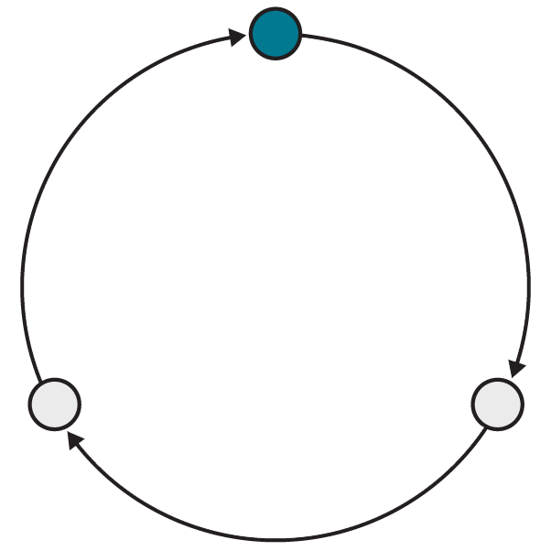
Why Loops?
Loops take advantage of what computers do best: evaluate instructions across organized sets of data very quickly.
Computers excel when working in isolated patterns, which is exactly how a loop works.
Avoid needlessly copying or re-typing code by repeating it in a loop.
Notes:
TEACHING TIPS:
You can also mention arrays of data coming from databases/other web apps — we have no idea how many there will be, so we can’t hardcode our operations in a giant copy-paste stack, even if we wanted to. We can use .length and loops, however!

Slide 27
An Iterator, Terminator, and Incrementer Walk Into a Loop...
A for loop is similar to an if statement but with more conditions. When creating a for loop, we need to make three declarations:
Define a starting variable to act as the iterator, typically named i.
Establish a condition for the loop to stop, called the terminating condition.
Increment the iterator variable (or decrement, if the loop goes backward).
for (let i = 0; i < 10; i++) {
console.log(i);
}
// outputs 0,1,2,3,4,5,6,7,8,9
Notes:
TALKING POINTS:
This is a good opportunity to break down how this loop would operate with a cross-chart, much like a manual debugger, tracking i’s value and talking through the steps out loud as you go.
“Iterator starts at 0. Is the iterator less than 10? Yes. Great, execute the code block, console log 0. Code block ends — we increment! Then, compare: Is i less than 1? Yes. Great! Keep going...”
Perhaps even demo using “debugger” in DevTools to walk through (pause) the for loop.

Slide 28
Loops + Arrays: A Classic Combination
Front-End Web Development
Notes:
TALKING POINTS:
The major use case for arrays is to create itemized groups of data computers can manipulate (often with loops). Loops are the most natural way for a computer to perform any operation that involves each item of an array.

Slide 29
for Loop + Arrays
Notice the highlighted terminating condition. The array's length limits the number of loops.
const myArray = ["John", "Benjamin", "Victor", "Serrao"];
for (let i = 0; i < myArray.length; i++) {
console.log(myArray[i]);
}
// outputs each name in the list, one at a time
Notes:
TEACHING TIPS:
This IS one of the few things worth memorizing, as this pattern for iterating over an array will come up countless times. If its an advanced class, you might get bold and also introduce a .forEach version of loops.

Slide 30
while Loop
The while loop, a simpler cousin of the for loop, will run as long as a condition remains true.
const myArray = ["John", "Benjamin", "Victor", "Serrao"];
let i = 0;
while (i <= myArray.length) {
// code to repeat
i++;
}
Notes:
TEACHING TIPS:
You could repeat the same procedure you did for manually stepping through the for loop, if you think there’s still any confusion on loops. We still have the conditional statement, and we have to be careful to ensure the condition eventually gets reached to avoid infinite loops!

Slide 31
Array method .forEach()
The array method forEach() performs a specific function for each of the items in an array. No need for an iterator or a limit.
const myArray = ["John", "Benjamin", "Victor", "Serrao"];
myArray.forEach(function(name) {
console.log(name);
})
// outputs each name in the list, one at a time
Notes:
TEACHING TIPS:
You could repeat the same procedure you did for manually stepping through the for loop, if you think there’s still any confusion on loops. We still have the conditional statement, and we have to be careful to ensure the condition eventually gets reached to avoid infinite loops!

Slide 32
for vs. while Loops
These loops seem so similar — which one should you choose? Most of the time, the answer is a for loop.
for loops are perfect for when you have a specific number of times you need the loop to run. In most cases, that number is the length of an array.
A while loop is useful when there’s no way of knowing how many times the loop will need to repeat — like a game loop that stops when a character dies.

Slide 33
Arrays and Loops Examples
We can see an interactive version of these examples, along with a very different way to perform DOM manipulations:
Reference code:
https://drive.google.com/drive/folders/19GlwseIAqAmpggnMHaUE-xHicKflmsyl?usp=sharing
‹#› | © 2020 General Assembly
Notes:
TEACHING TIPS:
Depending on how the class is going, this can be either an interesting introduction to jQuery or too much complication. Feel free to hide this slide during presentation and skip it if you think the students could use more time with arrays/loops without added complications. jQuery should be relatively easy to read after doing vanilla DOM manipulation this whole time!

Slide 34
Array and Loop Exercises
The following exercises demonstrate how loops can be used to display lists of information:
Reference code:
https://drive.google.com/drive/folders/19GlwseIAqAmpggnMHaUE-xHicKflmsyl?usp=sharing
‹#› | © 2020 General Assembly

Slide 35
return-ing to Functions
Front-End Web Development

Slide 36
return
Programs with multiple, reusable functions that process and return data are the next step in your journey.
function addThings(val1, val2) {
return val1 + val2;
}
let result = addThings(1, 2);
console.log(result);
Notes:
TEACHING TIPS:
Students up to now typically have used console.logs as the “output” of functions.
You can see the difference by thinking of a function is like vending machine: Console.logs simply tell you “Great, you ordered Cheetos,” while a return statement actually gives you the Cheetos. If we expect something to come out of a function, it has to use a return statement.

Slide 37
return + Conditions
Functions will often have conditions that change the nature of their output.
function addThings(val1, val2) {
if (val1 >= 10) {
return val1 + val2;
}
return 0;
}
console.log(addThings(11, 2));
console.log(addThings(7, 5));
Notes:
TEACHING TIPS:
This is a good time to mention that returns will exit the function immediately. Anticipate, or prompt yourself, the question of, “Why does this if not need an else?”

Slide 38

Practical Application
These examples may seem kind of silly (they are!), but that’s because our data is static.
Loops and functions become more important when we handle live data from APIs and databases, because they help us deal with information we haven’t defined ourselves!

Slide 39
Key Takeaways
For Next Time
Use Loops to Handle Arrays
Forms
Arrays can contain any amount of any data type.
Loops create dynamic, DRY code for iterating.
Use for loops for a specific number of iterations and while loops for unknown quantities.
We’ll use forms to collect data from users, validate the information they submit, and display error messages where they have submitted invalid values.
‹#› | © 2020 General Assembly

